Slide 1

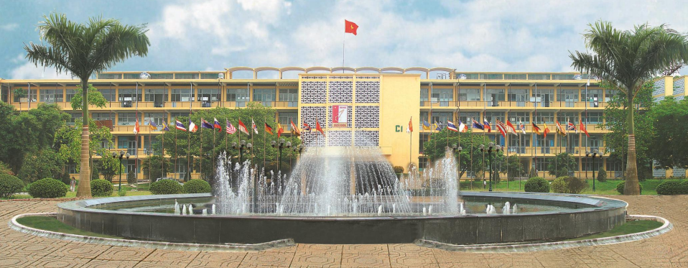
TRƯỜNG ĐẠI HỌC BÁCH KHOA HÀ NỘI
HANOI UNIVERSITY OF SCIENCE AND TECHNOLOGY
CHApter 2: planning function
DR. NGUYEN THANH HUONG

Slide 2
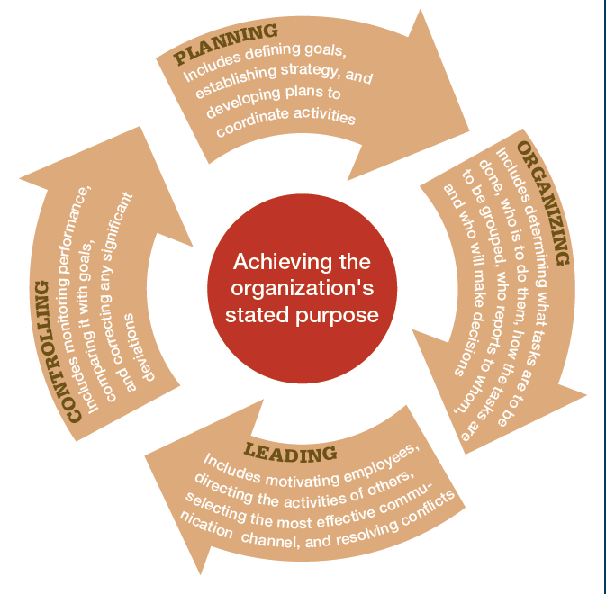
PROCESS OF MANAGEMENT

Slide 3

OBJECTIVES
HANOI UNIVERSITY OF SCIENCE AND TECHNOLOGY
Present the concept of planning and explain the significance of the planning function in organizations.
Differentiate between the types of plans used in organizations.
Explain and apply the characteristics of effective objectives for goal setting.
Describe planning methods and processes.
Present the foundations and principles of planning.

Slide 4
CONTENT
HANOI UNIVERSITY OF SCIENCE AND TECHNOLOGY
2.1. Planning concept
2.2. Role of planning function
2.3. Classification of plans
2.4. Principles of planning
2.5. Planning hierachy
2.6. Planning process
2.6.1. Planning foundation
2.6.2. Planning methods
2.6.3. Planning procedures

Slide 5

2.1. WHAT IS PLANNING?
Planning involves defining objectives, developing strategies, and outlining methods to achieve those objectives

Slide 6

2.1. WHAT IS PLANNING?
Vinamilk's goal in 2025: increase revenue by 10% compared to the previous year
Strategy: Research and Development (R&D), Mergers and Acquisitions (M&A), farm development
Action plan: R&D for pre-mixed formula milk, acquisition of GTN, farm development in various provinces

Slide 7
2.1. WHAT IS PLANNING?
What does the organization need to do?
How should it be done?
How are resources allocated for implementation?"

Slide 8
2.1. WHAT IS PLANNING?
5W1H
5W2h
5W1H2C5M

Slide 9
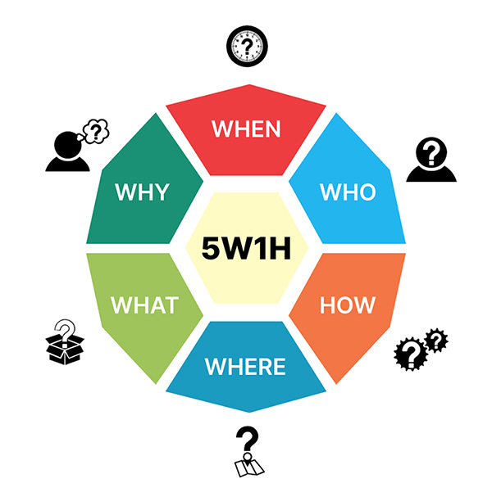

Slide 10
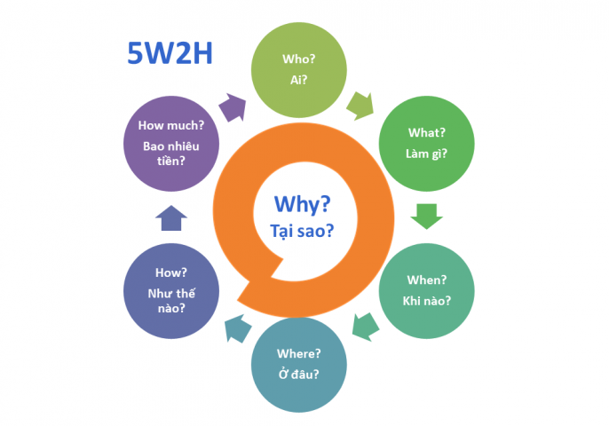

Slide 11
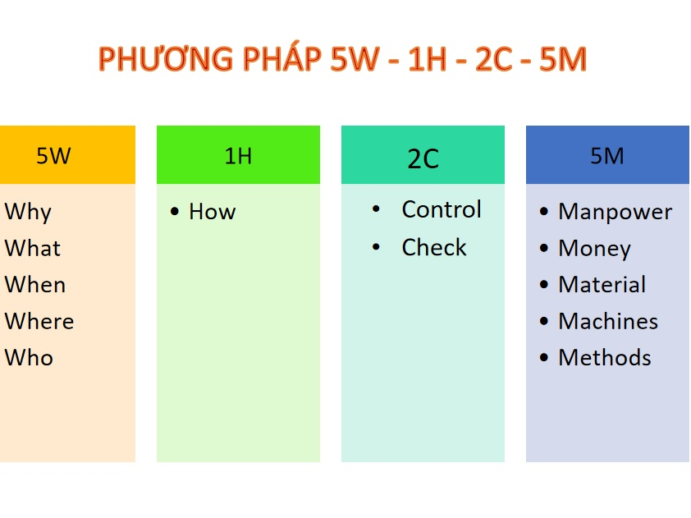
2.1. WHAT IS PLANNING?

Slide 12
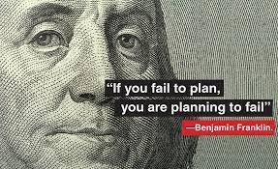
2.2. THE ROLE OF PLANNING FUNCTION
For the organization
Develop with direction
Optimize resource utilization
Adapt to environmental changes
Establish standards to apply during inspection

Slide 13
THE COST OF PLANNING
Time Management
The planning process demands a significant amount of time and effort (if done thoroughly).
Delays in decision-making

Slide 14

2.3. PRINCIPLES OF PLANNING
Proactive Planning
Involvement of managers at all levels in the planning process
Creating an environment for planning and implementation within the organization
Coordinating and prioritizing different plans
Ensuring flexibility

Slide 15

2.4. CLASSIFICATION OF PLANS
Definition of plans
Types of plans

Slide 16


2.4. CLASSIFICATION OF PLANS
Definition of a plan
- The result of planning process
- A temporal set of intended future course of actions through which one expects to achieve specific goals or objectives.
- Involves 3 main elements: Objectives, action schedules and budget.

Slide 17
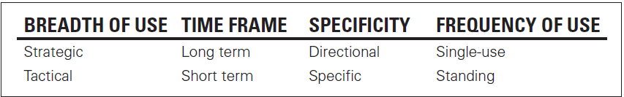

2.4. CLASSIFICATION OF PLANS

Slide 18
2.4. CLASSIFICATION OF PLANS
STRATEGIC PLANS
TACTICAL PLANS
Establish the general goals of the company and its position within the environment.
Formulate long-term strategic plans that serve as the foundation for organizational development.
This involves defining objectives, business philosophy, and setting priorities for policy-making.
Related to the implementation of specific strategies in specific situations and within a short timeframe.
It involves devising tactics or specific steps to execute strategic plans.
The main content includes defining short-term activity programs and utilizing allocated resources to accomplish tasks.

Slide 19
Planning hierarchy
2.5. PLANNING HIERACHY
Goals
Objectives
Strategies
Budgets
Policies
Procedures and Rules
Programs
Strategic plans
Tactical plans

Slide 20

Planning and levels of management
2.5. PLANNING HIERACHY
STRATEGIC PLANS
TACTICAL PLANS
Top-level management
Middle-level management
First-line management

Slide 21

2.5. PLANNING HIERACHY
2.5.1. Goals
A goal is a desired future state that an organization attempts to achieve. It represents the long-term motivation of organization in the legal framework and normal market practice.
To achieve the goal, it is supposed to set specific objectives and assignments

Slide 22

2.5. PLANNING HIERACHY
2.5.2. Objectives
Objectives imply concrete attainments that can be achieved by following a certain number of steps.
Each division in an organization has specific objectives→ harmonious combination of general objectives and specific ones.
Objecitves vary from period to period, from simple to complex in relation to organizational life cycle

Slide 23
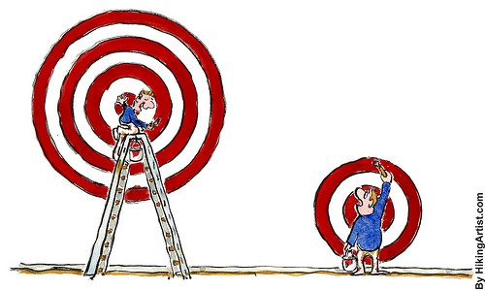
2.5. PLANNING HIERACHY
Classification
Timeframe: short-term, long- term
Management level of issuance: Strategic and operational

Slide 24
2.5.2. OBJECTIVES
Ensure the alignment of objectives
Company | Increase profit by 8% compared to 2024
Fabric Manufacturing Plant | Increase production capacity of the manufacturing line by an additional 3000 tons. Increase revenue by 1.5 billion VND
Technical department | Increase equipment operational time to 85% and maintain machinery maintenance costs.
Maintenance team | Ensure machine maintenance time is 175 hours per year

Slide 25
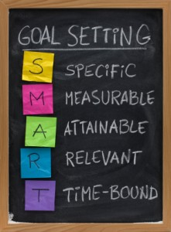
SMART criteria
2.5.2. OBJECTIVES

Slide 26
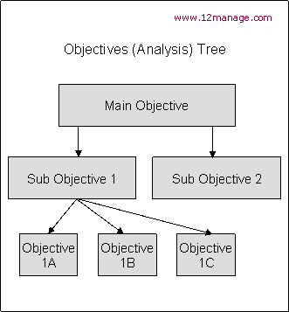
2.5. Sơ đồ tháp kế hoạch
MỤC TIÊU

Slide 27
2.5. PLANNING HIERACHY
2.5.3. Strategies
Definition of strategies
Types of strategies
Steps in building a strategy

Slide 28

2.5. PLANNING HIERACHY
Definition of strategies
An organizational strategy is the sum of the actions that a company intends to take to achieve specific objectives. It consist of following contents:
Elementary objectives in the organization
General guidelines for the organization in long- term
Resources and potentials used to achieve objecitives
Operating policies in attracting and using required resources as well as potentials to reach objectives
Control and evaluate

Slide 29

2.5. PLANNING HIERACHY
Types of strategies
Strategies provide overall directions to enterprises. There are some types of strategy for specific fields as follows:
Product strategies
Marketing strategies
Technological strategies
Financial strategies
Organizing strategies
Human resource strategies (HR)
Relationship strategies
Notes:
Those strategies used by an organization’s various functional departments (marketing, operations, finance/accounting, human resources, and so forth) to support the competitive strategy.
Voice:
Trong DN có các Chiến lược cấp chức năng khác nhau như: chiến lược Nghiên cứu và phát triển sản phẩm, chiến lược MKT, chiến lược công nghệ, chiến lược sản xuất, chiến lược nhân sự , chiến lược tài chính...
Chiến lược nghiên cứu và phát triển
Vai trò nổi bật của nghiên cứu và phát triển trong việc nỗ lực để đạt được hiệu quả cao hơn gồm hai điểm:
Chức năng R&D có thể nâng cao hiệu quả nhờ thiết kế sản phẩm dễ dàng chế tạo, vì có thể giảm đáng kể thời gian lắp ráp, dẫn đến năng suất cao hơn và chi phí thấp hơn.
Sự cải tiến quá trình, tức là sự cải tiến về cách thức vận hành quả trình sản xuất để cải thiện hiệu quả. Những cải tiến quá trình thường là một nguồn lực chính của lợi thế cạnh tranh.
Chiến lược vận hành:
Chiến lược quyêt định xem sản phẩm sẽ được sản xuất như thế nào và ở đâu, quyết định về sự phối hợp cần thiết, sự sắp xếp các nguồn lực và mối quan hệ với người cung ứng
Chiến lược Marketing
Chiến lược marketing có thể tác động mạnh mẽ đến hiệu quả và cấu trúc chi phí của một doanh nghiệp. Qua chiến lược marketing, công ty giành được vị thế nhờ phối trí các hoạt động định giá, thiết kế sản phẩm và phân phối. Chiến lược cạnh tranh của DN là một yêu tố quan trọng ảnh hưởng đến chiến lược vận hành và ngược lại chiến lược vận hành phải được thiết kế để đạt đến mục tiêu của chiến lược cạnh tranh
Chiến lược nguồn nhân lực
Năng suất lao động là một trong những yếu tố quyết định then chốt cho hiệu quả và cấu trúc chi phí của một doanh nghiệp. Năng suất lao động càng cao, chi phí cho một đơn vị sản phẩm càng giảm. Thách thức đối với chức năng quản trị nguồn nhân lực trong một công ty là tìm ra cách thức làm tăng năng suất lao động. Có ba lựa chọn cơ bản để làm điều này, đó là: huấn luyện người lao động, tổ chức lực lượng lao động thành các nhóm tự quản, nối kết giữa tiền công và sự thực hiện.
Chiến lược tài chính
Mục tiêu của chiến lược tài chính là xây dựng quỹ và thiết lập một cấu trúc tài chính thích hợp, giúp doanh nghiệp đạt được những mục tiêu đã đặt ra. Một số nội dung cần chú ý trong chiến lược tài chính gồm: hoạch định dòng tiền, xem xét tương quan giữa nợ và vốn; chính sách cổ tức.

Slide 30
2.5. PLANNING HIERACHY
Steps in building a strategy
There are 4 key steps in building an organizational strategy:
Evaluate the situation of organization (Where’s the organization?)
Determine strategic objectives (Where does organization want to go?)
Determine the required tasks to implement (What should organization do?)
Carry out strategic objectives, strategic tasks (How to implement efficiently?)

Slide 31
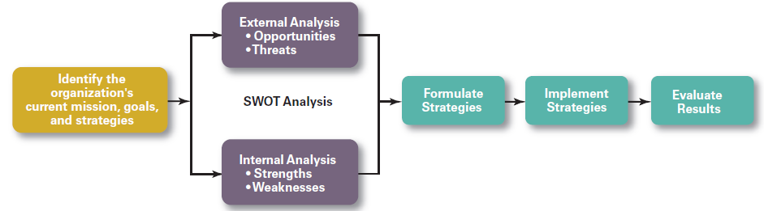
Steps in the Strategic Management Process
Notes:
The strategic management process, seen here in Exhibit 5-2, is a six-step process that encompasses:
Strategy planning
Implementation
Evaluation
Even the best strategies fail if management doesn’t implement or evaluate them properly.
Now let’s look at each of these six steps independently.

Slide 32
External and Internal Analyses
External Analysis
Competition
Components of environment
Threats and opportunities
Internal Analysis
Resources
Capabilities
Core competencies
Organizational strengths and weaknesses
Notes:
In STEP 2, managers conduct an external analysis so they can:
Know what the competition is doing, how pending legislation might affect the organization, and how stable the local labor supply is in locations where it operates.
Examine all components of the environment—that is, economic, demographic, political/legal, sociocultural, technological, and global—to see the trends and changes.
Pinpoint opportunities that the organization can exploit and threats that it must counteract.
In STEP 3, managers conduct an internal analysis, which provides critical information about an organization’s specific resources and capabilities. An organization’s resources are its assets—financial, physical, human, and intangible—that it uses to develop, manufacture, and deliver products to its customers.
In comparison to assets, its capabilities are its skills and abilities in doing the work activities needed in its business. The major value-creating capabilities of the organization are known as its core competencies. Both resources and core competencies determine the organization’s competitive weapons.
After completing an internal analysis, managers should be able to identify organizational strengths and weaknesses. Any activities the organization does well or any unique resources that it has are called strengths. Weaknesses are activities the organization doesn’t do well or resources it needs but doesn’t possess.
The combined external and internal analyses are called the SWOT analysis because, together, they are an analysis of the organization’s strengths, weaknesses, opportunities, and threats.
After completing the SWOT analysis, managers are ready to formulate appropriate strategies that:
(1) Exploit an organization’s strengths and external opportunities, and
(2) Buffer or protect the organization from external threats.

Slide 33
1. Evaluate the situation of organization (Where’s the organization?) SWOT analysis
 | Strengths | Weaknesses
Opportunities | S-0 strategies | W-O strategies
Threats | S-T strategies | W-T strategies

Slide 34
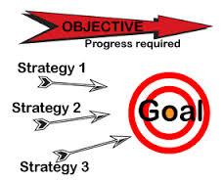
2. Determine strategic objectives
-Where does organization want to go?
- Answer: desired position, desired rate of business growth, etc.

Slide 35
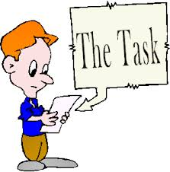
3. Determine the required tasks to implement
- What should organization do?
- Determining specific job ‘s duties for each divisions

Slide 36
4. Carry out strategic objectives, strategic tasks
(How to implement efficiently?)
Organizing corporate system in accordance with implementing strategic objectives
Implementing, controlling, evaluating and adjusting ( if necessary)

Slide 37

2.5. PLANNING HIERACHY
2.5.4. Polices
A policy is a standing plan that furnishes broad guidelines for taking action consistent with reaching strategic objectives.
A policy provides guidance to managers who must make decisions about circumstances that occur frequently within the organization.

Slide 38
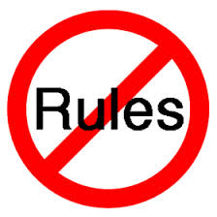
2.5. PLANNING HIERACHY
2.5.5. Rules
A rule is a standing plan that designates specific required action. It indicates what an organization member should or should not do and allows no room for interpretation.
Rules are not intended to serve as guidelines for making organizational decisions; instead, they provide detailed and specific regulations for action.

Slide 39

2.5. PLANNING HIERACHY
2.5.6. Procedures
A procedure is a standing plan that outlines a series of related actions that must be taken to accomplish a particular task.
Procedures outline more specific actions than policies do.
Managers must be careful to apply the appropriate organizational procedures for the situations properly and pay attention to time sequence in procedures.

Slide 40

2.5. PLANNING HIERACHY
2.5.7. Programs
A program is a single use plan that govern a relatively compre­hensive set of activities that are designed to accomplish a particular set of goals.
Such plans outline the major steps and specific actions necessary to implement the activities prescribed by the program.
The timing and sequencing of the efforts of individuals and units are also articulated in the plan.

Slide 41

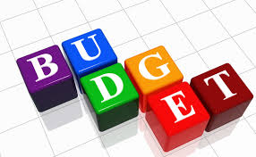
2.5. PLANNING HIERACHY
2.5.8. Budgets
A budget is a statement of allocation of (scarce) resources to achieve an organization's objectives for a specific time period.
It is the financial plan for how an organization will receive and spend money for a set time period
It details how funds will be spent on labour, raw materials, capital goods, information systems, marketing and so on, as well as how the funds will be obtained.

Slide 42

2.6. PLANNING PROCESS
Planning foundation
Internal factors
External factors
Planning methods
Traddtional
MBO
Factors afecting quality of a plan
Planning procedure

Slide 43
PLANNING FOUNDATION
INTERNAL | EXTERNAL
Human resource | Competitors
Financial capabilities | Customers
Machinery & equipment | Suppliers
Technology | Distributors
 | Relevant agencies
 | Characteristics & Focasted Industrial Development Trends

Slide 44
PLANNING METHODS
Traditional way:
General objectives are established by top-managers. Then, they are assigned to lower –levels in an organization
Managament By Objectives (MBO):
MBO is applied to motivate employees instead of used as a tool for supervision.
MBO is a system in which specific performance objectives are jointly determined by subordinates and their supervisors.
Progress toward objectives is periodically reviewed and rewarded are allocated on the basis of that progress

Slide 45
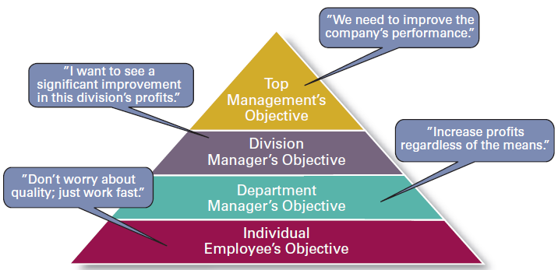
Traditional Goal Setting

Slide 46
Management by Objectives
Goal specificity
Participative decision making
Explicit time period
Performance feedback

Slide 47
PLANNING METHODS
Traditional way:
General objectives are established by top-managers. Then, they are assigned to lower –levels in an organization
Managament By Objectives (MBO):
MBO is applied to motivate employees instead of used as a tool for supervision.
MBO is a system in which specific performance objectives are jointly determined by subordinates and their supervisors.
Progress toward objectives is periodically reviewed and rewarded are allocated on the basis of that progress

Slide 48
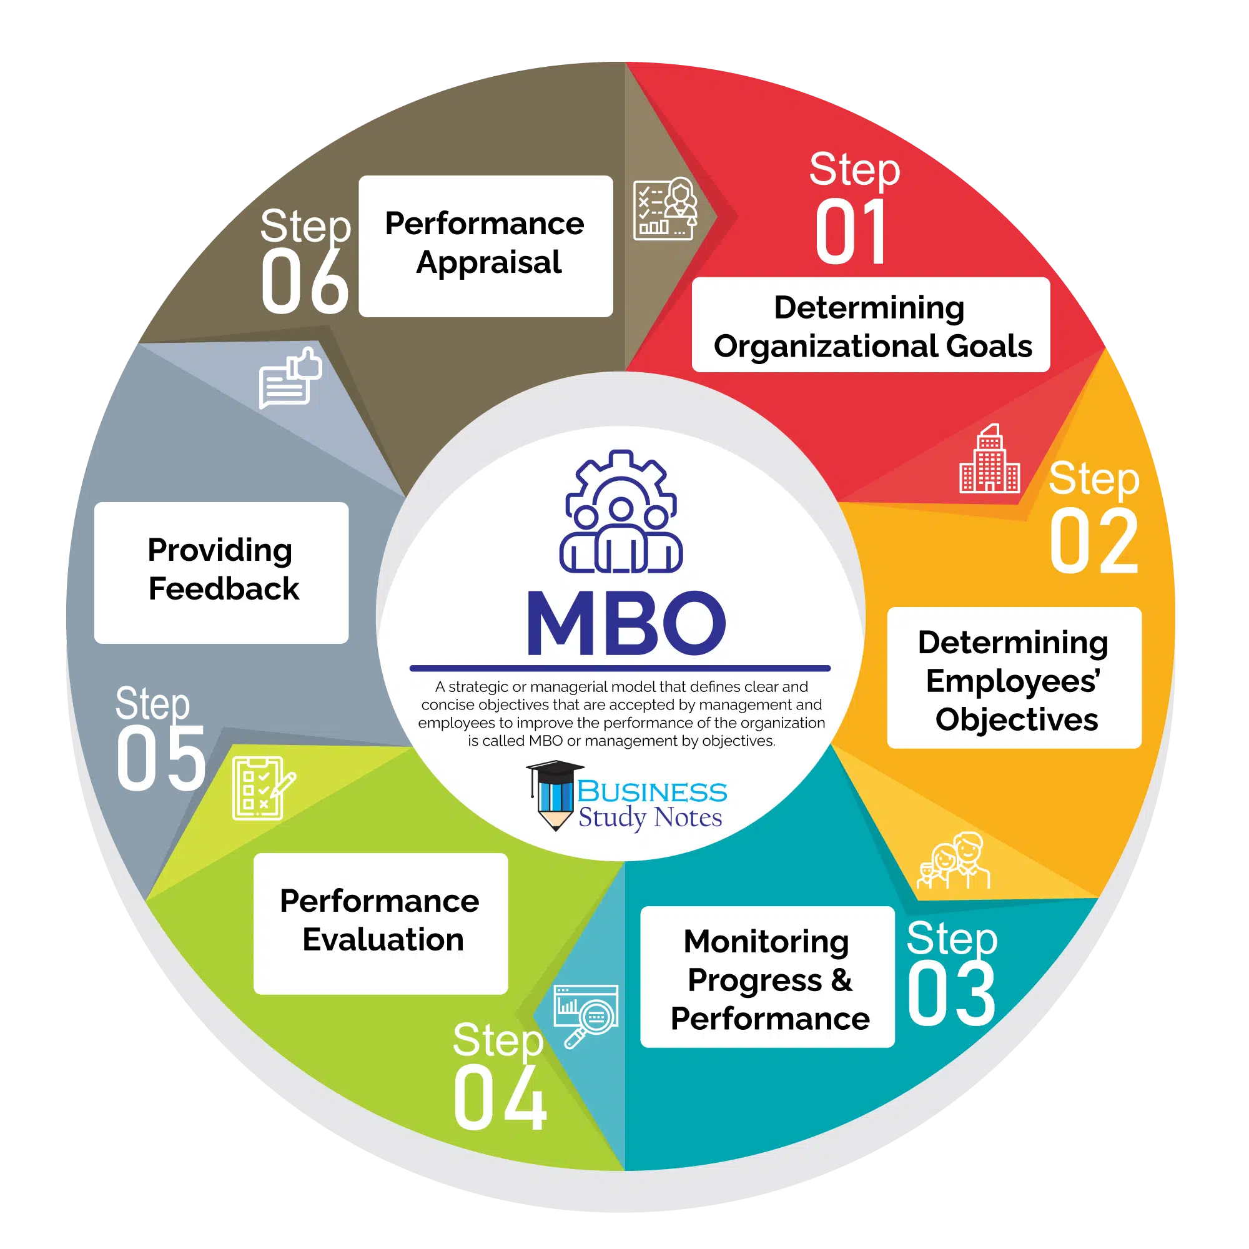
Step in management by objectives process
Notes:
https://corporatefinanceinstitute.com/resources/management/management-by-objectives-mbo/#
https://www.businessstudynotes.com/hrm/principle-of-management/steps-in-process-of-management-by-objectives/
Alright, let's break down the MBO process into simple steps:
STEP
1- Define Goals
- Start by defining the goals of the organization(Set Clear Goals) .
These goals are like the destination for the entire team. –Keep in mind the SMART in setting GOALs
It's crucial to involve different managers to make sure we cover everything the company aims to achieve.
( The objectives set by the supervisors who play a key role. They provide their insights, setting goals based on based on an interpretation and evaluation of what the company can and should achieve within a given timeframe).
STEP 2: Individual Goals:
After everyone knows the big goals, it's time for each employee to define their own targets.
Managers have one-on-one chats with their team members to discuss what each person can achieve personally.
In simple words, this step of MBO is a two-way process rather than one-way.
→ It means superiors don’t impose or forces these objectives on employees.
Rather, superiors suggest these goals to employees-------→ and employees accept them or ask for changes if available resources are not feasible for certain objectives.
- It's like tailoring the big goals to fit everyone's skills and resources.
It's all about making sure each person's objectives contribute to the overall success.
(( Employees share their thoughts on what's doable for the organization or their department.)
STEP 3: Constant monitoring performance and progress
Keeping things on track is important.
With MBO, it's not just about setting goals and forgetting them.
Managers keep an eye on how everyone is doing.
It's like a continuous check-in to see if things are moving in the right direction.
STEP 4. Performance Evaluation
: Managers and employees sit down together.
It's a chance for both sides to talk about what went well, what could be improved, and if the goals were met.
It's like a report card, but more about growth and improvement.
STEP 5. Providing Feedback- Performance Review:
Think of it like a coach talking to players during a game.
In MBO, there's constant feedback.
Managers don't wait until the end to say how things went.
They keep the communication flowing, pointing out what's going well and where adjustments can be made.
→ The main purpose of feedback is to identify the deviations and shortcomings to improve the quality rather than focusing on criticism.
Step 6. Performance Appraisal:
Performance appraisals are a regular review of employee performance within organizations.
It is done at the last stage of the MBO process.
*****. Keep in mind that different organizations might use these terms differently or combine them into a single comprehensive process.
-→( It means MBO helps employees and superiors in career advancement, skill improvement, and self-improvement.)
-----
Providing Feedback (Step 4):
- Nature: It's an ongoing, continuous process.
- Timing: Happens regularly, not confined to specific review periods.
- Purpose: Aims to offer immediate insights & guidance.
- Discussion: Involves real-time discussions on day-to-day activities and specific projects.
- Outcome: Focuses on immediate adjustments & improvements, contributing to the ongoing performance.
----
Management by Objectives (MBO) is a smart way to boost how well an organization performs. It's a method where the organization's goals are set by the management and shared with all the team members to achieve. In MBO, we keep a close eye on how well each employee is doing by checking their progress against the goals.
What's cool about MBO is that when employees are part of setting goals and deciding how to reach them, they are more likely to meet their responsibilities. It's like having everyone on the same team, working towards success!

Slide 49
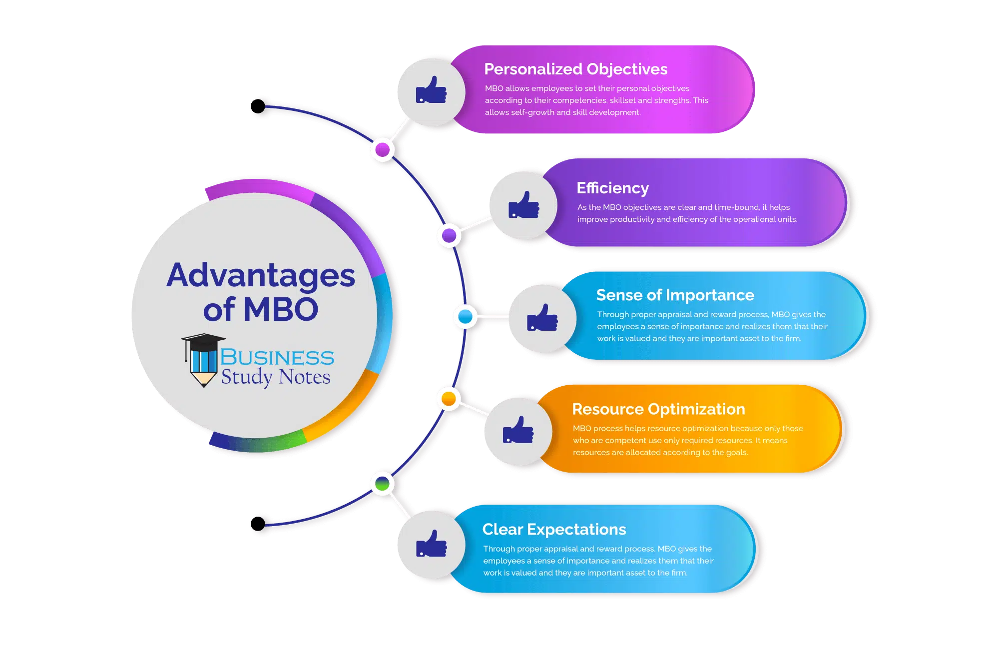

Slide 50

Notes:
While there are advantages to MBO, it also comes with some limitations:
Time Consuming: The entire MBO process, involving goal setting, appraisal, reviews, monitoring, and evaluation, can be time-consuming and requires extensive paperwork.
Faulty Evaluation Process: Occasionally, managers may evaluate employees based on their own perspectives and competencies, rather than the employees' actual skill set, leading to biased evaluations.
Limited Growth: Since employees contribute to setting goals based on their existing skill set, there might be limited room for self-growth, as some employees may resist trying new and innovative ideas.
Negative Competition: When bosses reward employees for their accomplishments, it might accidentally lead to unhealthy competition among the team, where everyone tries too hard to outperform each other with any price
Too Much Expectation: Managers might have unrealistic expectations, treating employees as ideal without allowing room for mistakes. This can result in conflicts between management and the workforce.
CONCLUSION
In conclusion, MBO is a crucial tool for managers to align employee skills with organizational goals.
The six steps in the MBO process as we have just discussed
Nowadays, More and more companies are trying adopt MBO to enhance productivity and efficiency by involving every individual in setting and achieving measurable goals.
Despite its advantages, MBO, like any management tool, has both limitations and benefits.
When utilized effectively, MBO can significantly enhance overall organizational performance.
Hết SLIDE này trở lại SLIDE 2.6
-----
Goals-Oriented: MBO tends to emphasize goals and objectives rather than focusing on the actual action plan and the steps to achieve them.
Goal Settings and Organizational Culture: MBO might face limitations in determining the nature of goals – whether they should be long-term or short-term, quality-focused or quantity-focused. Additionally, MBO primarily concentrates on goals and objectives, overlooking the broader organizational culture.

Slide 51
Factors affecting quality of a plan
PLANNING METHODS
Investment for planning
Planners’ capacity
Necessary information
Planning method /process
Evaluation for feasibility of a plan
51
Notes:
51

Slide 52
PLANNING PROCEDURE
Being aware of opportunities
Considering planning premises
Evaluating alternative courses
Establishing objectives
Selecting the best course
Formulating supporting plans
Determining alternative courses
Quantifying plans by making budgets

Slide 53

PLANNING PROCEDURE
1. Being aware of opportunities
Searching for, analyzing, and screening the most promising business opportunities:
One must be aware of what opportunities the company is facing in terms of production and business in general.
At any given time, a company may be presented with various opportunities.
Due to limited resources, it can only pursue turning a few opportunities into reality.

Slide 54
PLANNING PROCEDURE
2. Considering planning premises
The step is to estimate market demand, organizational environment; evaluate the current ability, production capacity, capital, materials reserve…
Analyze and evaluate strengths and weaknesses covering the whole organizations. For example :
+Finance (Profit; ROE; ROA; Solvency…)
+Production and technology ( labour productivity; technology; product quality; R&D ability…)
+ Human resources (labour quality, labour structure, managerial ability…)

Slide 55
PLANNING PROCEDURE
Step 3. Establishing objectives
Answering the question of what a business aims to achieve after implementing a business opportunity:
Planning objectives indicate the endpoint of the planning process, where the company will reach.
Depending on the stage of development, there are corresponding characteristic indicators.
Note: there should be alignment between the overall goals and specific objectives, between long-term goals and short-term goals.

Slide 56
PLANNING PROCEDURE
Step 4. Determining alternative courses
Searching for and examine alternative courses of action which is based on detemined objectives and premises.
A business can follow various different paths, each of which entails different costs and yields different revenues for the company, so there are multiple options to choose from.

Slide 57
PLANNING PROCEDURE
Step 5. Evaluating alternative courses
Conduct qualitative & quantitative analysis to identify feasible options:
After proposing different options, we need to establish evaluation criteria based on the objectives and prerequisite conditions.
Assess both qualitative and quantitative factors.

Slide 58
PLANNING PROCEDURE
Step 6. Selecting the best course
The step is to make a decision based on evaluated results.
The optimal course of action is selected in accordance with detemined standards in each circumstance

Slide 59
PLANNING PROCEDURE
Step 7. Formulating supporting plans
A major plan often requires supporting plans to achieve objectives efficiently
Step 8. Create a budget
Determine the financial resources required to execute the plan.

Slide 60

HANOI UNIVERSITY OF SCIENCE AND TECHNOLOGY

